Slide 1
Phenotype Development and Evaluation Workgroup OHDSI 2025 symposium face to face meeting
Mind Meets Machines –
AI generated concept set vs human
October 9th, 2025

Slide 2
Meet the workshop team
Principal Investigators: Azza Shoaibi PhD (PI), Christopher Mecoli MD (PI), Gowtham Rao MD, PhD (PI)
Scientific Advisors: Patrick Ryan PhD, Martijn Schuemie PhD, Jack Murphy PhD
Master of ceremony: Gaurav Dravida
Institutional Review Board of Record: John Hopkins University
Reminder: Recorded. Informed Consent. Online vs Onsite.

Slide 3
Workgroup scope
Mission: We improve the quality and reliability of the evidence generated from observational data, by advancing the science of phenotype development and evaluation.
Areas of focus:
Content development and dissemination (Library)
Best practice development and evaluation (Application)
Science of phenotyping (Methods research)
Tool design and innovation (CohortDiagnostics)

Slide 4
Workgroup: What have we achieved together over the last 5 years?
OHDSI phenotype library (Hosting 500+ cohort definitions)
4 phenotype phebruary (2022-2025)
5 peer review publications on phenotypes
Supported over 10+ OHDSI network studies :
from covid, how often, SOS challenges to Guideline-driven evidence generation.
Established many collaborators

Slide 5

Jamie Weaver

Slide 6


2025 OKR
Objective: Enhance the Science of Phenotyping and Best Practices.​
Publish a paper/communication on OHDSI Phenotype Library (Q2) ​
Cohort Definition quality: (Q2,Q3) ​
Cohort Hygiene/Atlas 3.0​
Regulatory grade phenotyping
Evaluation of advanced methods for Concept set generation through AI (Q4)
Objective: Community Engagement and Educational Outreach.​
Complete Phenotype Phebruary 2025 (Q1)
Complete the integration of OHDSI library into CIPHER and submit a paper about it (Q1,Q2) - VA team/Gowtham
Evaluate the medication Inappropriate Medication phenotypes across the network- Q1 ​
Maintenance and development of tools​
Complete 3 refreshments of the Phenotype library with major releases by Q4 2025
OHDSI Phenotype library application

Slide 7
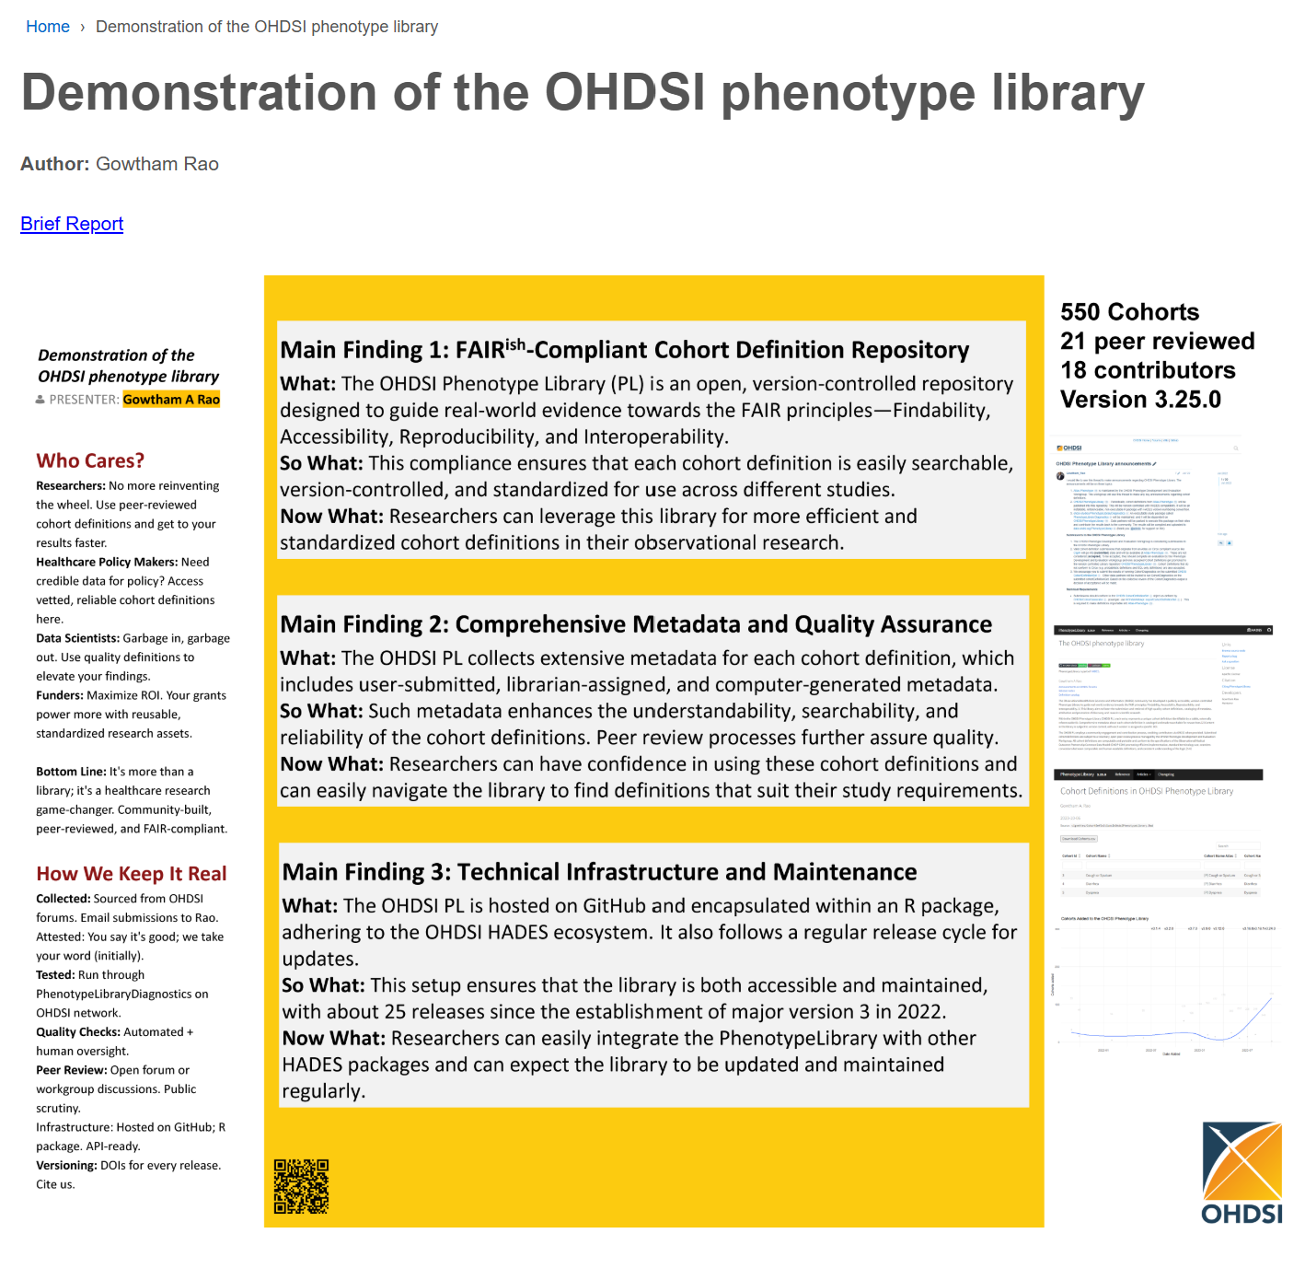
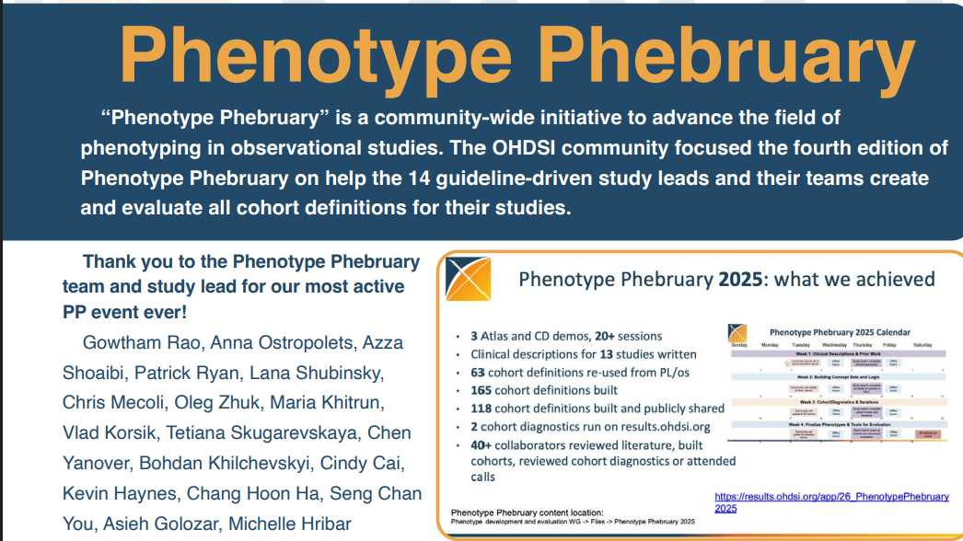
Workgroup Accomplishments
A growing engaged community of collaborators!

Slide 8
Our Agenda today
8:00 AM - 8:30 AM: Welcome & Logistics
- Introduction to Project Objectives, Informed , Team Assignments
8:30 AM - 9:45 AM: Phase 1: Human Concept Set Creation
“Split and Reconcile”
9:45 AM – 9:55 AM: Break
9:55 AM – initial results
9:55 AM - 10:15 AM:
- AI methodology leads – ~10 min each
10:15 AM - 11:30 AM: Phase 2: Blinded Adjudication
11:30 AM - 12:00 PM: The Reveal & Wrap-Up

Slide 9
Mind Meets Machines - Primary objective
Study Objectives and Hypotheses
1.1. Primary Objective: To evaluate the performance (accuracy) of GenAI-driven approaches compared to a rigorous, consensus-based, human-led workflow for the task of translating standardized clinical descriptions into phenotype concept sets (code list), utilizing a dynamically created gold standard.
1.2. Primary Hypotheses: The primary analysis focuses on the comparison of the primary performance metric, the Prevalence-Weighted F1 Score (F1W​), between the (1:k) GenAI workflows and the (1) human-led workflow.
Null Hypothesis (H0​):
There is no significant difference in the Prevalence-Weighted F1 Score (F1W​) between the concept sets generated by the GenAI-driven workflow(s) and the concept sets generated by the rigorous, human-led workflow.
Alternative Hypothesis (H1​):
There is a significant difference in the Prevalence-Weighted F1 Score (F1W​) between the concept sets generated by the GenAI-driven workflow(s) and the concept sets generated by the rigorous, human-led workflow.

Slide 10
Mind Meets Machines – Secondary objective
1.2. Secondary Objectives:
To characterize the baseline variability and agreement across all independent workflows (Human and AI) prior to adjudication.
To quantify inter-human variability and the improvement gained through the human consensus process (Consensus Gain).
To analyze the clinical impact of disagreements using prevalence-weighted scoring metrics.
To conduct sensitivity analyses based on source vocabularies (e.g., ICD-10-CM).
To conduct a qualitative analysis of human reasoning and consensus-building processes.

Slide 11
Quality Improvement Experimental Design
2.1. Quality Imrpovement Study Design: This is a methodological evaluation utilizing a parallel assignment, multi-arm, comparative experimental design with mixed methods (quantitative and qualitative analysis).
2.2. Data Structure and Standardization: The experiment compares the outputs of different methodologies applied to the same ~7 standardized pre-specified clinical ideas. The design is paired, meaning all experimental arms process the same inputs. Statistical analysis will account for this pairing to control for variability in difficulty between clinical ideas. The version of the OMOP vocabulary used is standardized across all workflows to the August 27th, 2025 version.
2.3. Sample Size and Power: The study includes N=7 standardized clinical ideas. Given this small sample size, the study has limited statistical power to detect small or moderate differences. Therefore, the analysis will focus primarily on descriptive comparisons and the magnitude of observed differences. Inferential statistics (p-values and Confidence Intervals) will be considered exploratory rather than confirmatory.

Slide 12
Experimental Arms and Procedures
3.1. Arm 1: Human Workflow (Control/Benchmark) A rigorous "Split and Reconcile" model is employed to mitigate groupthink and establish a robust human benchmark.
- Stratified Randomization: Participants self-report expertise (Clinical and Informatics). Stratified randomization ensures a balanced mix of expertise across teams.
- Independent Creation (Phase 1): For each clinical idea, participants are divided into 2 or more independent sub-teams working in parallel using standard OHDSI tools (ATLAS, PHOEBE). The use of GenAI is prohibited.
- Reconciliation: The sub-teams convene and utilize a Modified Delphi (Delphi-like) method, facilitated by an expert honest broker, to negotiate a single, finalized concept set.
- Data Capture: Discussions during the creation and reconciliation phases are audio-recorded for qualitative analysis, authorized by informed consent.
3.2. Arm 2: GenAI Workflows (Intervention) Multiple distinct GenAI pipelines (denoted as ) participate.
- Autonomous Execution: Generation of concept sets must be autonomous.
- Constraints: "Human-in-the-loop" (HITL) intervention, post-editing of the AI-generated output, and sequential prompting (prompting may occur only once) are strictly prohibited.
- Submission: GenAI teams must submit their outputs by October 8th, 2025, 6:00 PM EST, along with documentation of their methodology.

Slide 13
Evaluation Strategy and Adjudication
The evaluation focuses exclusively on the accuracy of the resolved concept list. The MMM Challenge employs a dynamic, post-hoc "On-the-Fly Adjudication" model to establish the True Gold Standard (TGS).
4.1. The Adjudication Process and Blinding:
- Pooling: The union of all concepts generated across all N experimental arms is compiled.
- Delta Identification:
The Intersection (Automatic Gold Standard - AGS): Concepts universally agreed upon.
The Delta: Concepts where any disagreement exists.
- Blinded Adjudication: Adjudicators (Outcomes Assessors) review the Delta, strictly blinded to the source (Human vs. AI) of each concept. To prevent bias, the interface displays only intrinsic concept information (Name, Vocabulary, hierarchy, prevalence) and excludes the "Agreement Level".
- Adjudication Execution: A designated clinical expert makes the final determination (Yes/No only) on whether to include each disputed concept in the TGS. Other participants may provide input, but the designated expert holds final decision authority. A neutral volunteer ("Honest Broker") may be present to ensure the adjudicator remains strictly true to the original clinical description, preventing definition drift.
- TGS Definition: The TGS is constructed by combining the AGS plus the concepts from the Delta approved by the blinded adjudicators.
- Conflict Mitigation: Experts adjudicating a specific domain cannot participate in the concept set creation for that domain.

Slide 14
Statistical Analysis Plan (SAP)
The study design necessitates a structured, two-phased approach to the Statistical Analysis Plan (SAP). The analysis first seeks to understand the variability of the inputs (Phase A) and then proceeds to measure the accuracy of the outputs against the TGS (Phase B).
5.1. Phase A: Pre-Adjudication Analysis (Before TGS Creation)
- This analysis occurs immediately after Phase 1 (independent creation) and before human reconciliation or adjudication. It utilizes the raw outputs from all independent workflows (all human sub-teams and all AI pipelines) to address Secondary Objective 1.
- Objective: To quantify and visualize the similarities and differences across all independent experimental workflows in a blinded manner.
5.2. Phase B: Post-Adjudication Analysis (After TGS Creation)
- This analysis occurs after the TGS has been established through blinded adjudication. It compares the performance of the finalized Human Workflow (reconciled output) and the AI pipelines against the TGS to address the Primary Objective and remaining Secondary Objectives.
5.2.1. Primary Objective Analysis
- Primary Outcome Measure: Prevalence-Weighted F1 Score (): The harmonic mean of precision and recall against the TGS, weighted by concept prevalence ().
Metric Calculation:
We calculate weighted counts for True Positives (WTP), False Positives (WFP), and False Negatives (WFN) relative to the TGS:
WTP=∑i∈TP​Vi​ ; WFP=∑i∈FP​Vi​ ; WFN=∑i∈FN​Vi​
Weighted Precision (PW​) and Weighted Recall (RW​):
PW​=WTP+WFPWTP​ ;
RW​=WTP+WFNWTP​

Slide 15
Statistical Analysis Plan
The significance level (Alpha) for all exploratory hypothesis testing will be set at 0.05.
Descriptive Statistics: Descriptive statistics (mean, median, SD, range, 95% CI) for the (and related metrics: Precision, Recall, weighted/unweighted) will be reported for the Human Workflow (reconciled output) and each AI pipeline.
Comparative Analysis: The difference in scores between each AI workflow () and the Human workflow () will be calculated for each clinical idea. Paired differences will be summarized (mean difference, 95% CI of the mean difference).
Exploratory Inferential Analysis (Paired Comparisons): To test the primary hypothesis (), the normality of the paired differences will be assessed (e.g., Shapiro-Wilk test). A Paired t-test (if normal) or Wilcoxon Signed-Rank Test (if non-normal) will be used. Given the small sample size (N=7), the Wilcoxon Signed-Rank Test is generally preferred if there is any doubt about the normality assumption.
Exploratory Non-Inferiority Assessment: We will explore if GenAI approaches are non-inferior to the human workflow. The non-inferiority margin () is pre-specified as 0.05. This margin represents the maximum acceptable reduction in that would still render the AI approach practically comparable. Non-inferiority is suggested if the lower bound of the 95% CI for the mean difference () is greater than (i.e., > -0.05).
Multiple Comparisons Adjustment (Exploratory): As multiple AI pipelines are compared against the single Human control, Dunnett's Test will be used to adjust the CIs and p-values for the exploratory inferential analyses (both difference and non-inferiority), controlling the family-wise error rate.

Slide 16
Secondary objectives
5.2.2. Secondary Objectives Analysis
Inter-Human Variability and Consensus Gain (Objective 2):
Inter-Human Variability: Calculate the average pairwise F1 score between all combinations of the n independent human sub-teams (using Phase 1 outputs).
Consensus Gain: Use a paired test (Wilcoxon Signed-Rank Test preferred) to compare the F1 scores (vs TGS) of the independent human sub-teams against the F1 score (vs TGS) of the reconciled human output.
Clinical Impact of Disagreements (Objective 3):
Calculate Spearman's Rank Correlation Coefficient between the scores and the Unweighted F1 scores across all workflows. A low correlation indicates that performance is highly sensitive to concept prevalence.
Source Vocabulary Analysis (Objective 4):
Sensitivity Analysis: The primary descriptive analysis will be repeated using the Source Vocabulary F1 Score (calculated against the TGS based on source codes).
Qualitative Analysis of Human Reasoning (Objective 5):
Thematic Analysis: Transcribed audio recordings from the Human Reconciliation and Adjudication phases will be analyzed using thematic analysis to identify patterns in reasoning and consensus-building. Transcripts will be independently coded by two researchers, with assessment of inter-coder reliability (e.g., Cohen's Kappa).

Slide 17
Logistics
Everyone has a sticker?
Do you have your table?
Do you have the packet?

Slide 18
Phenotype Development and Evaluation Workgroup
Come join us

